Slide 1


SMART INDIA HACKATHON 2024
Problem Statement ID – 1607
Problem Statement Title- A smart AI based solution for traffic management on routes with heavy traffic from different directions, with real-time monitoring and adaptation of traffic light timings
Theme- Smart Automation
PS Category- Software
Team ID- 22187
Team Name – SmartLanes_7852

Slide 2
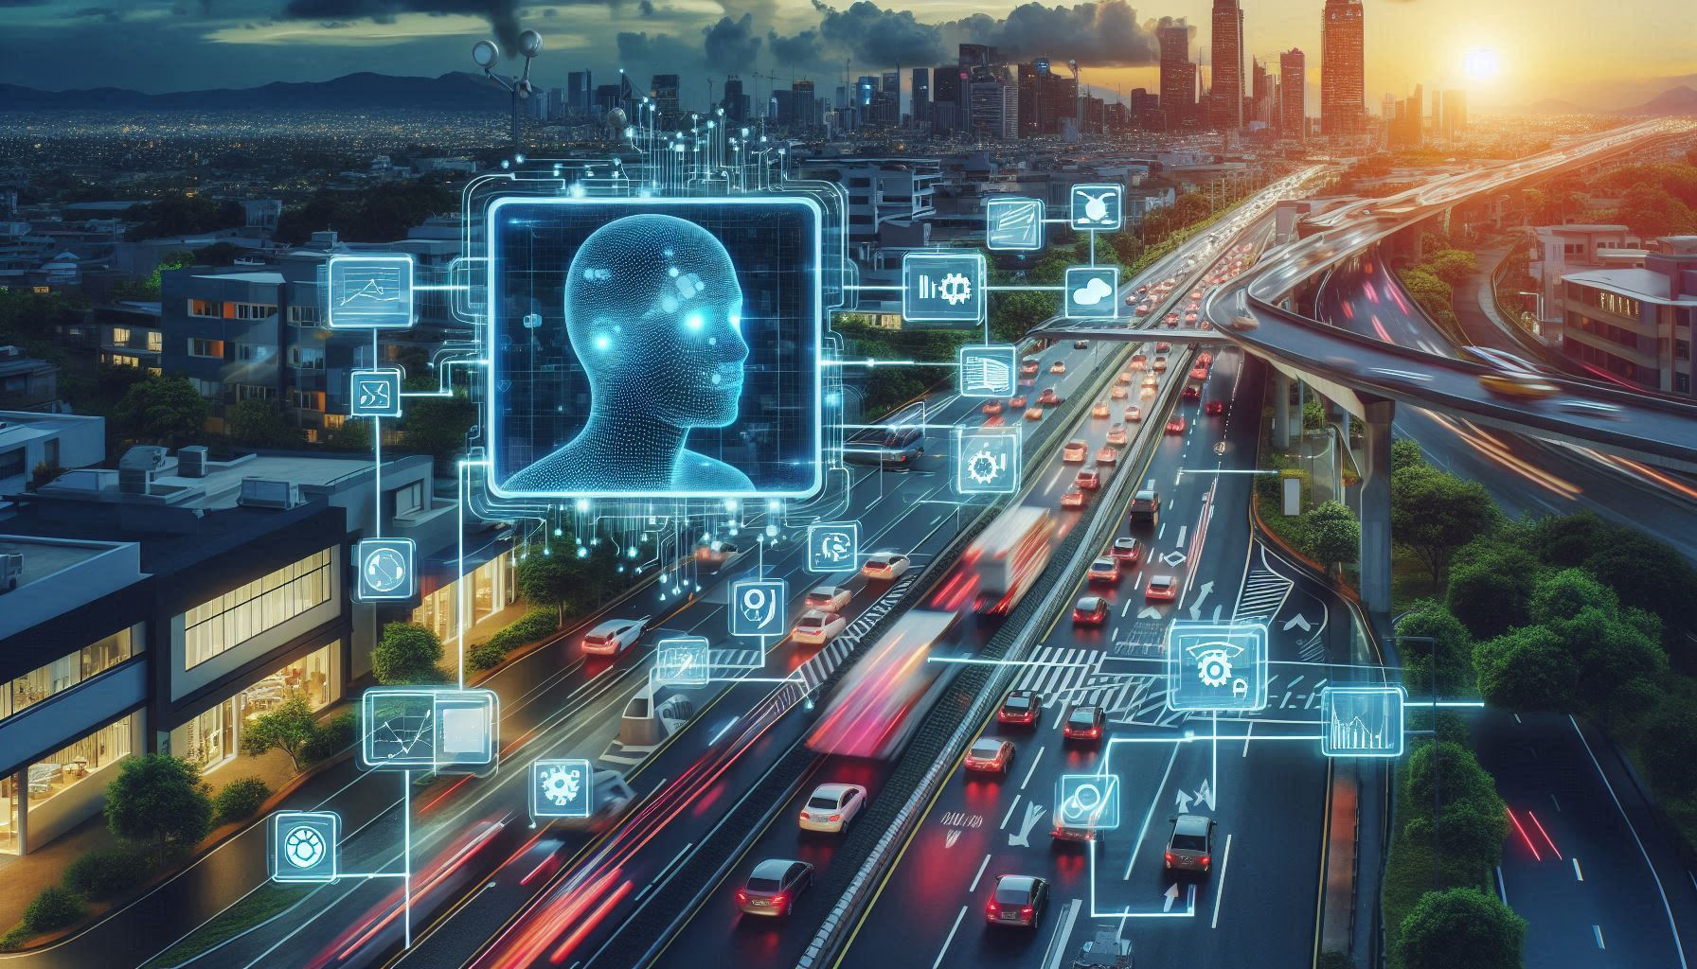
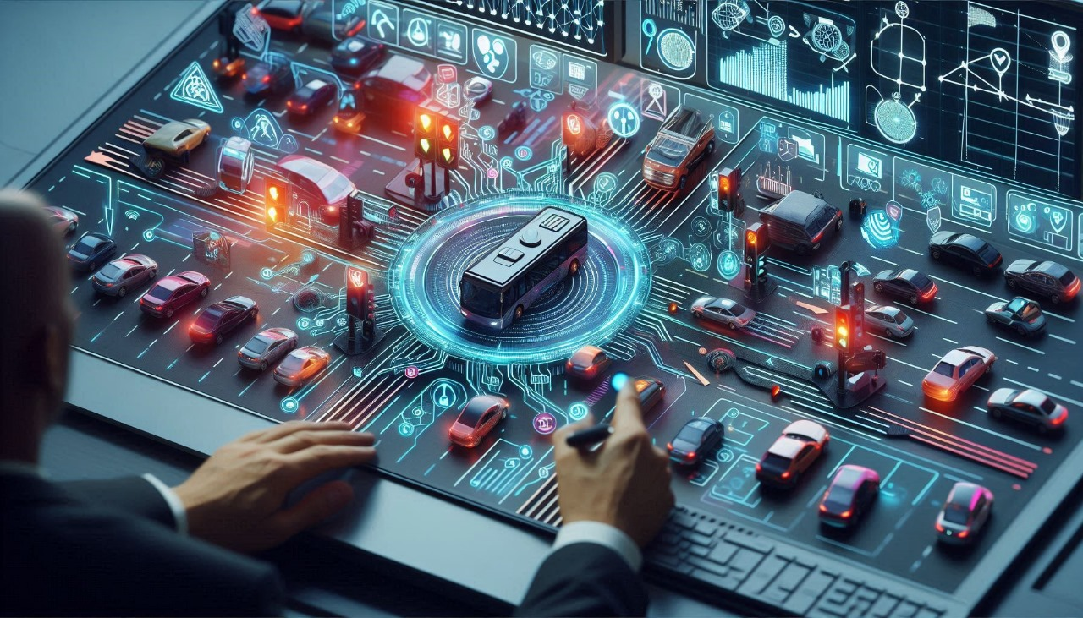
SmartLanes - Optimizing Traffic Light Timings
SmartLanes
Real-Time Data Collection
Deploy sensors and cameras at intersections.
Integrate GPS data from vehicles for comprehensive monitoring.
AI-Driven Traffic Analysis
Utilize machine learning algorithms to model and predict traffic patterns.
Simulate and optimize traffic light timings dynamically.
Adaptive Control System
Implement real-time adjustments to traffic light timings based on current conditions.
Prioritize emergency vehicles and adjust for peak traffic periods.
Centralized Management
Develop a control platform with a real-time dashboard for monitoring and adjustments.
Ensure seamless communication between traffic lights and control systems.
Public Communication
Provide real-time traffic updates and alerts via mobile apps and electronic signs.
Enhance user experience with timely information on traffic conditions.
BUSINESS MODELS:
Subscription-Based
Data Analytics
Cloud Infrastructure
Real-Time Optimization
Custom Solutions
IoT Integration
Scalable Licensing
Maintenance Services
Government Contracts
Traffic Reports

Slide 3
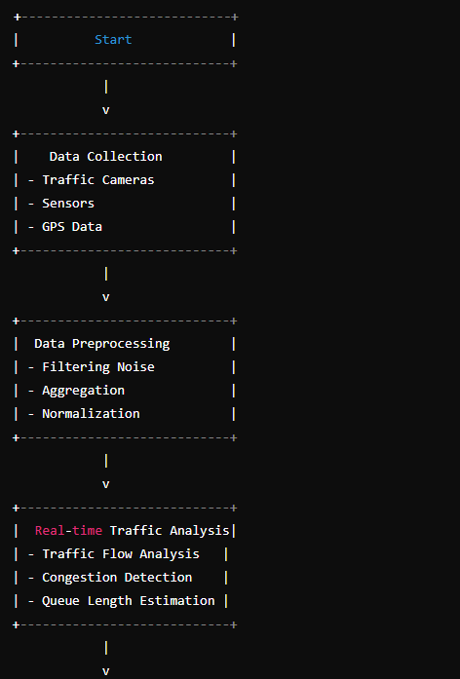
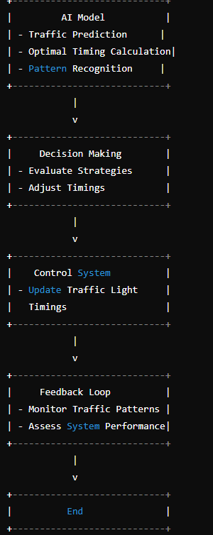
TECHNICAL APPROACH
SmartLanes
Smart AI-Based Traffic Management Solution
Data Collection
Deploy sensors (loops, cameras, radar)
Integrate GPS data from vehicles
Utilize historical traffic data
Data Processing
Real-time analysis of traffic data
Data fusion from multiple sources
Traffic Flow Modeling
AI algorithms for traffic flow prediction
Simulation of traffic light timing changes
Dynamic Traffic Light Control
Adaptive timing based on real-time data
Priority rules for emergency and peak times
Communication System
Seamless integration of lights, sensors, and control systems
Secure and reliable data transfer
Centralized Control System
Central management platform
Real-time monitoring dashboard
Feedback Loop
Performance monitoring and adaptive learning
Continuous improvement of traffic light timings
User Interface
Public communication (apps, signs)
Real-time alerts for drivers
Security Measures
Data protection and cybersecurity
System integrity safeguards
Scalability and Maintenance
Scalable design for increased traffic and intersections
Regular maintenance and updates

Slide 4








FEASIBILITY AND VIABILITY
SmartLanes
VIABILITY
FEASABILITY
HARDWARE REQUIREMENTS
1. Traffic Cameras/Sensors: To capture real-time traffic data.
o Cameras: For visual data (can be standard or high-resolution).
o Sensors: Such as inductive loops, radar, or lidar for vehicle counting and speed measurement.
2. Computing Hardware:
o Edge Devices: For processing data close to the source, such as Raspberry Pi or NVIDIA Jetson modules..
o Servers: For centralized data processing and running AI algorithms.
3. Traffic Light Controllers: Hardware to control the traffic signals based on instructions from your software.
4. Networking Equipment: Routers, switches, and possibly cellular modems for communication between sensors, servers, and traffic lights.
Technological Readiness: Advanced sensors, AI algorithms, and real-time data processing are well-developed and available.
Integration Capability: Established communication standards enable seamless integration with existing infrastructure.
Scalability: Systems are designed to handle increasing traffic volumes and additional intersections.
Cost Efficiency: Reduces long-term costs through optimized traffic flow and reduced congestion-related delays.
Improved Traffic Management: Enhances safety and efficiency by dynamically adjusting traffic light timings.
Public Acceptance: Benefits such as reduced travel times and lower emissions contribute to high public and governmental support.
SOFTWARE REQUIREMENTS

Slide 5
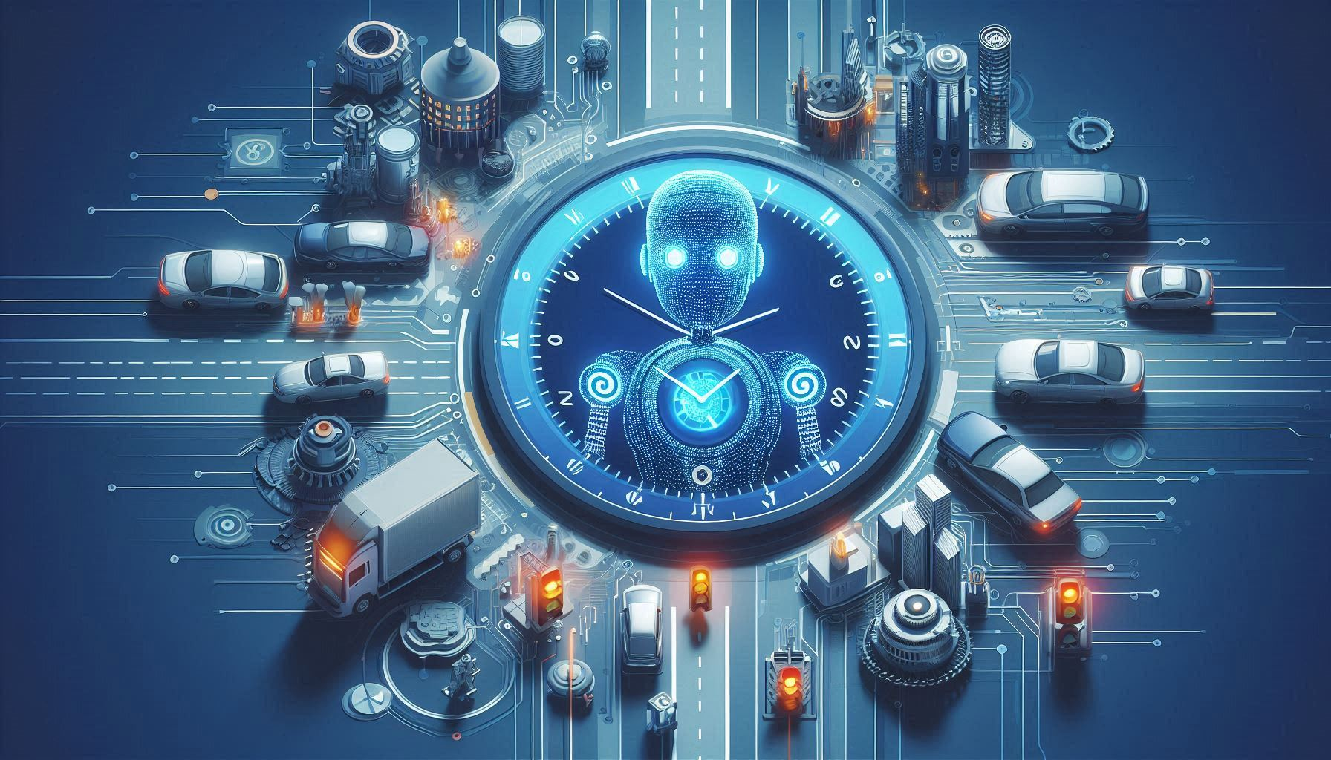

IMPACT AND BENEFITS
SmartLanes
Traffic Flow Improvement
Reduced Congestion: Optimized light timings decrease traffic bottlenecks.
Smoother Flow: Enhanced coordination of traffic signals improves overall traffic movement.
Increased Safety
Fewer Accidents: Better traffic management lowers the risk of collisions.
Emergency Response: Prioritization for emergency vehicles reduces response times.
Environmental Benefits
Lower Emissions: Reduced idling and stop-and-go driving decrease vehicle emissions.
Fuel Efficiency: Improved traffic flow leads to lower fuel consumption.
Economic Advantages
Reduced Travel Time: Shorter travel times save fuel and increase productivity.
Cost Savings: Decreases costs associated with traffic delays and accidents.
Enhanced Public Experience
Real-Time Information: Provides drivers with up-to-date traffic conditions and alerts.
Increased Convenience: Better traffic management improves overall commuter experience.
Data-Driven Insights
Traffic Pattern Analysis: Provides valuable data for future urban planning and infrastructure development.
Adaptive Learning: System learns and adapts to changing traffic patterns over time.

Slide 6
RESEARCH AND REFERENCES
SmartLanes
AI & Traffic Management
"Adaptive Traffic Signal Control with Reinforcement Learning" – Research on using reinforcement learning for real-time traffic light adjustments.
Journal of Traffic and Transportation Engineering (2021)
Real-Time Data Integration
"The Role of Real-Time Data in Urban Traffic Management" – Study on integrating real-time data from sensors and GPS for traffic optimization.
IEEE Transactions on Intelligent Transportation Systems (2020)
Dynamic Traffic Systems
"Dynamic Traffic Light Control Systems: A Review" – Overview of various approaches to adaptive traffic light systems.
Transportation Research Part C: Emerging Technologies (2019)
Environmental Impact
"Impact of Adaptive Traffic Signal Control on Emissions and Fuel Consumption" – Analysis of environmental benefits from optimized traffic light timings.
Journal of Environmental Management (2022)
Case Studies
"Case Study: Implementation of AI-Based Traffic Management in Smart Cities" – Evaluation of real-world implementations and their outcomes.
Smart Cities Journal (2023)

